Slide 1
The Battle of Neighborhoods
By: Hugo Anderica

Slide 2
Introduction
In New York’s demographics it is shown that it is an enormous diversity in its food, due to the so many cultures that are settled in there. As a result of this diversity there are a many restaurant in New York based on the cultureof their owner like Chinese, Taiwanese, Italian etc

Slide 3
Problem
To find the answers to the following questions:
1. List and visualize all major parts of New York City that has great Indian restaurants.
2. What is the best location in New York for Indian food?
3. Which areas have potential Indian restaurants market?
4. Which all areas lack Indian restaurants.
5. Which is the best place to stay if you prefer Indian food?

Slide 4
Data Section
For this project we need the following data:
New York City data that contains list Boroughs, Neighbourhoods along with their latitude and longitude.
Data source : https://cocl.us/new_york_dataset
Indian restaurants in each neighbourhood of New York City.
Data source : Foursquare API
GeoSpace data
Data source : https://data.cityofnewyork.us/City-Government/Borough-Boundaries/tqmj-j8zm

Slide 5
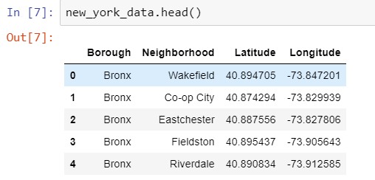
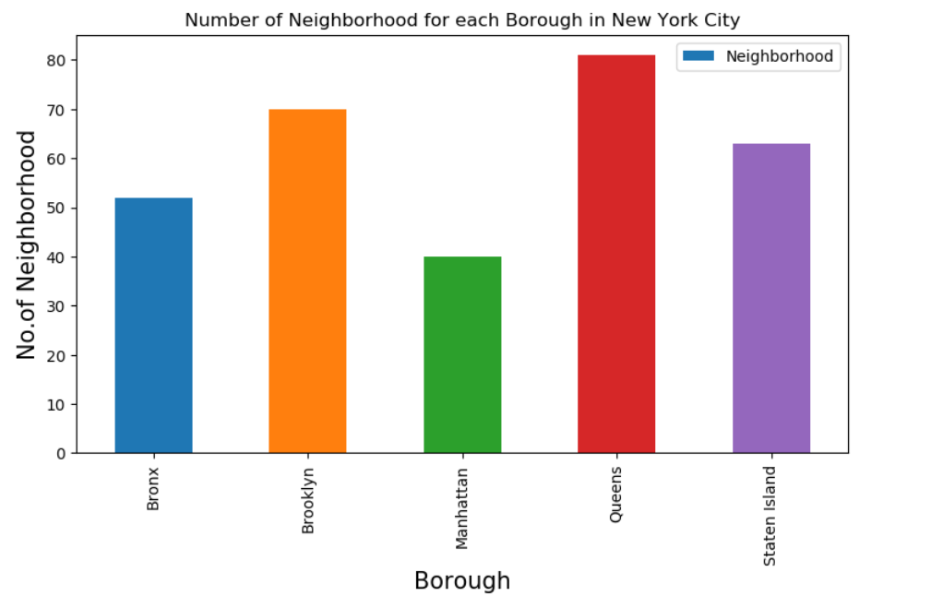
Find all venues for each neighborhood with the help of Foursquare API

Slide 6
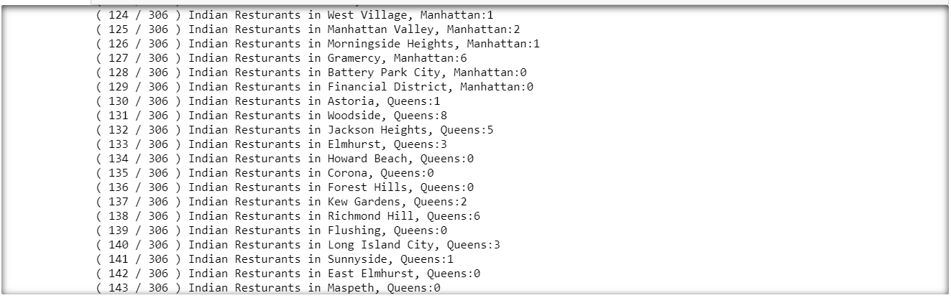
The venues with Indian restaurants on it are filtered for further analysis

Slide 7
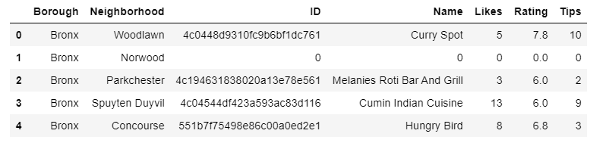
Find the ratings, likes, and tips of all the Indian restaurants using Foursquare API

Slide 8
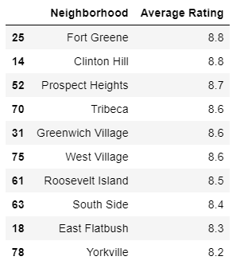
Filter neighborhoods and ratings from the original dataset

Slide 9
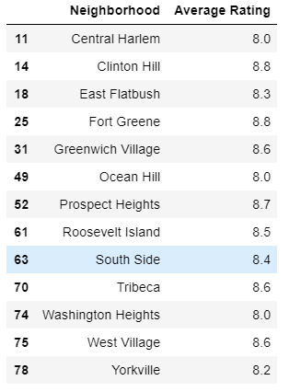
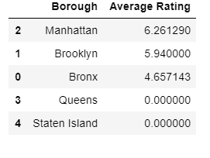
Average Rating of each borough and neighborhood

Slide 10
Filtering neighborhoods based on their rating

Slide 11
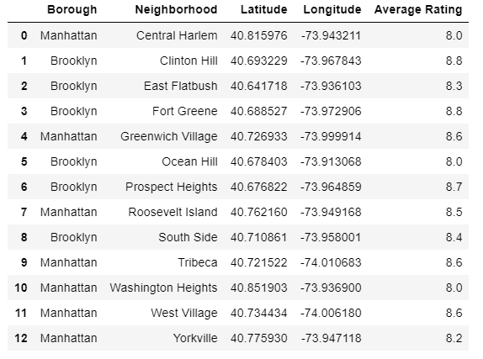
Joining the ratings and locations dataset

Slide 12

Markers on map

Slide 13
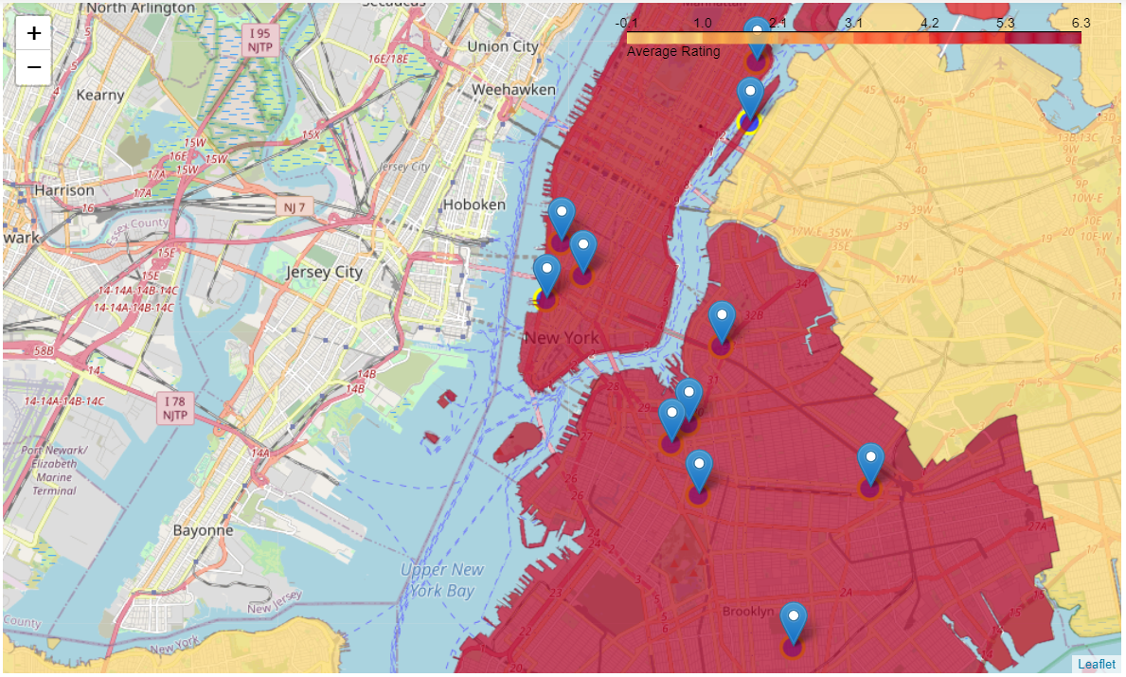
Choropleth map

Slide 14
Conclusion
So now we can answer the questions asked above in the Questions section:
Answers:
The following location in New York City has great Indian restaurants.

Slide 15
Conclusions
Astoria (Queens), Blissville (Queens), Civic Center (Manhattan) are some of the best neighbourhoods for Indian cuisine.
Manhattan have potential Indian Restaurant Market.
Staten Island ranks last in average rating of Indian Restaurants.
Manhattan is the best place to stay if you prefer Indian Cuisine.

